Slide 1




Career Bridge
Where You Can Vision Your Dreams
Nidhi Jani (20210702114)
Anjali Sharma (20210702082)

Slide 2

Objective
Establish an advanced job matching algorithm which effectively connects job seekers with appropriate employment opportunities based on their skills, experience, and preferences..
Designing user friendly website interface to ensure a seamless and enjoyable experience for both job seekers and employers.

Slide 3
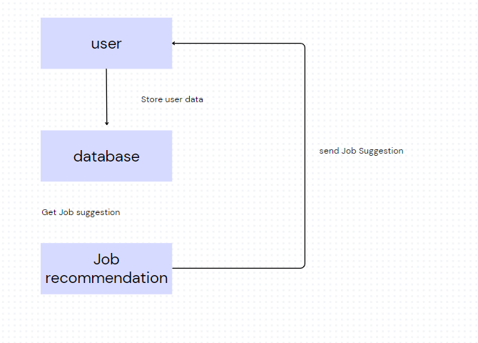
Flow Diagram

Slide 4

Future Scope
Blockchain Technology:
It enhance security, transparency, and trust in the recruitment process. It is used utilized to verify the authenticity of resumes.
Networking and Social Integration:
Networking functionalities help job seekers connect with industry peers, mentors, and potential employers, expanding their professional circles.

Slide 5

Technologies
Html
CSS
Javascript
Bootstrap
PHP

Slide 6


